Slide 1
Technologies in IoT
Topic - II

Slide 2
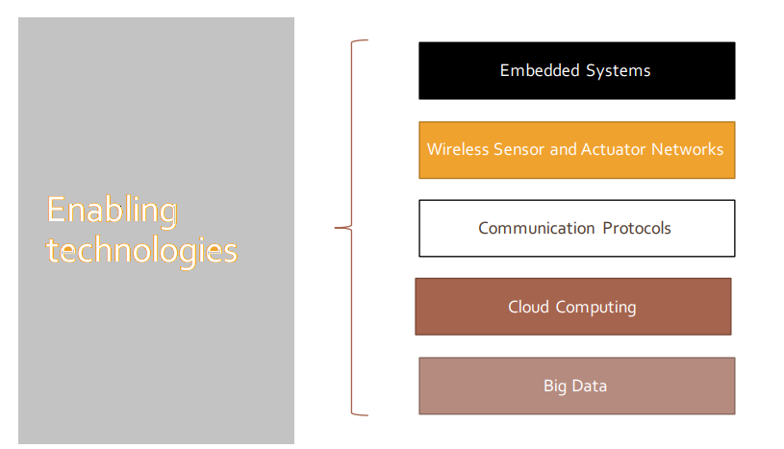
IoT Enabling Technologies
Notes:
Embedded Systems
Hardware and Software embedded to do specific task
Mp/Mc, RAM,ROM,cache,ethernet/wifi,flash,display,keybord, OS(optional), firmware/application software
Big Data Analytics
The large amount of data which cannot be stored using traditional databases and data processing tools qualify as Big data. Big data analytics have various steps starting from cleansing, munging(wrangling), processing and visualization. Few examples of Big data generated by IoT systems are weather monitoring, Health monitoring, retail inventory monitoring etc..
Volume
Velocity
Variety
Cloud Computing
Provisioning on demand as metered service as "pay as you go"
IaaS
Provides users the ability to provision computing and storage resources. These resources are provided as virtual machine instances and virtual storage.Users can start, stop,configure and manage the virtual machine instances and virtual storage. Users can deploy OS and application on the virtual resources provisioned on the cloud.
Storage
Computing
PaaS
Provides users the ability to develop and deploy applications in cloud using the development tools, API's, software libraries and services provided by the cloud service provider. The cloud service provider manages the underlying cloud infrastructure including network,storage,OS and servers. The users themselves are responsible for developing,deploying,configuring and managing applications on the cloud infrastructure.
Network
Servers
Operating Systems
SaaS
Provides the users complete software application or the user interface to the application itself. Cloud service provider takes care of all the underlying infrastructure including network,storage,OS, servers and application software. As the cloud service provider manages both the application and data, users are able to access the applications from anywhere.
Thin client interface: Browser

Slide 3
Embedded Systems
Hardware and Software embedded to do specific task
Mp/Mc, RAM, ROM, cache, ethernet/wifi, flash, display, keybord, OS(optional), firmware/application software
Big Data Analytics
The large amount of data which cannot be stored using traditional databases and data processing tools qualify as Big data. Big data analytics have various steps starting from cleansing, munging(wrangling), processing and visualization. Few examples of Big data generated by IoT systems are weather monitoring, Health monitoring, retail inventory monitoring etc..
Volume
Velocity
Variety

Slide 4
Cloud Computing
Provisioning on demand as metered service as "pay as you go"
IaaS
Provides users the ability to provision computing and storage resources. These resources are provided as virtual machine instances and virtual storage. Users can start, stop, configure and manage the virtual machine instances and virtual storage. Users can deploy OS and application on the virtual resources provisioned on the cloud.
Storage
Computing
PaaS
Provides users the ability to develop and deploy applications in cloud using the development tools, API's, software libraries and services provided by the cloud service provider. The cloud service provider manages the underlying cloud infrastructure including network, storage, OS and servers. The users themselves are responsible for developing, deploying, configuring and managing applications on the cloud infrastructure.
Network
Servers
Operating Systems
SaaS
Provides the users complete software application or the user interface to the application itself. Cloud service provider takes care of all the underlying infrastructure including network, storage, OS, servers and application software. As the cloud service provider manages both the application and data, users are able to access the applications from anywhere.
Thin client interface: Browser

Slide 5
Networking Technologies
Networking technologies enable IoT devices to communicate with other devices, applications, and services running in the cloud.
The internet relies on standardized protocols to ensure communication between heterogeneous devices is secure and reliable.
Standard protocols specify rules and formats that devices use to establish and manage networks and transmit data across those networks.
Networks are built as a “stack” of technologies. A technology such as Bluetooth LE is at the bottom of the stack.
While others such as such as IPv6 technologies (which is responsible for the logical device addressing and routing of network traffic) are further up the stack. Technologies at the top of the stack are used by the applications that are running on top of those layers, such as message queuing technologies.
This article describes widely adopted technologies and standards for IoT networking. It also provides guidance for choosing one network protocol over another. It then discusses key considerations and challenges related to networking within IoT: range, bandwidth, power usage, intermittent connectivity, interoperability, and security.

